Slide 1




HEALTH PROVIDER FRAUD DETECTION

Slide 2

PROBLEM OVERVIEW
Healthcare fraud costs the U.S. healthcare system billions annually
Fraudulent providers may:
Bill for services never performed
Upcode services
Submit claims for deceased patients
Goal: Build a machine learning model to flag high-risk providers

Slide 3
WHY DOES IT MATTER?
Fraud detection reduces large financial losses
Supports investigators by prioritizing suspicious providers
Improves Medicare program integrity
Manual fraud detection is slow → ML speeds up investigations

Slide 4
DATA USAGE
Beneficiary Data: age, chronic conditions, date of death
Inpatient Claims: admission dates, reimbursement amounts
Outpatient Claims: outpatient visit and service data
Provider Fraud Labels: identifies fraudulent vs. non-fraudulent providers

Slide 5
METHEDOLOGY
Raw Data → Cleaning → Feature Engineering
→ Provider-Level Aggregation → Train/Val/Test Split →
Modeling → Evaluation → Error Analysi

Slide 6

FEATURE ENGINEERING
Number of claims per provider
Total reimbursed amount
Average claim duration
Number of diagnosis codes
Number of unique beneficiaries
Beneficiary age distribution
Percentage of deceased beneficiaries
Inpatient/Outpatient claim ratios
Reimbursement per claim
Why: These features represent provider “behavior patterns”

Slide 7
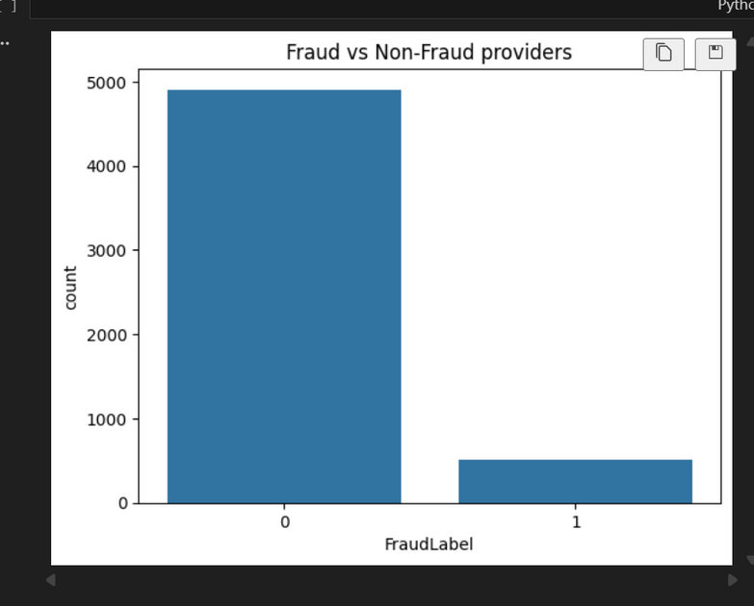
HANDLING CLASS IMBALANCE
Fraud cases represent ~8–10% of providers
Imbalance handling methods used:
class_weight="balanced"
SMOTE or oversampling
Focused on PR-AUC (better for rare-fraud detection

Slide 8
MODELS TESTED
Logistic Regression (baseline)
Decision Tree
Random Forest
Gradient Boosting (best performance)
SVM (optional)

Slide 9
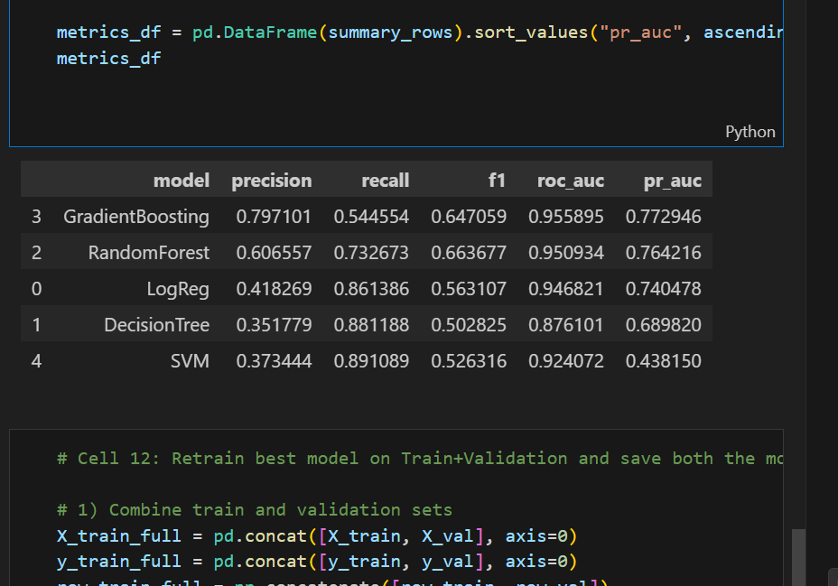

COMPARASION
Compared models using:
PR-AUC
ROC-AUC
Precision, Recall, F

Slide 10
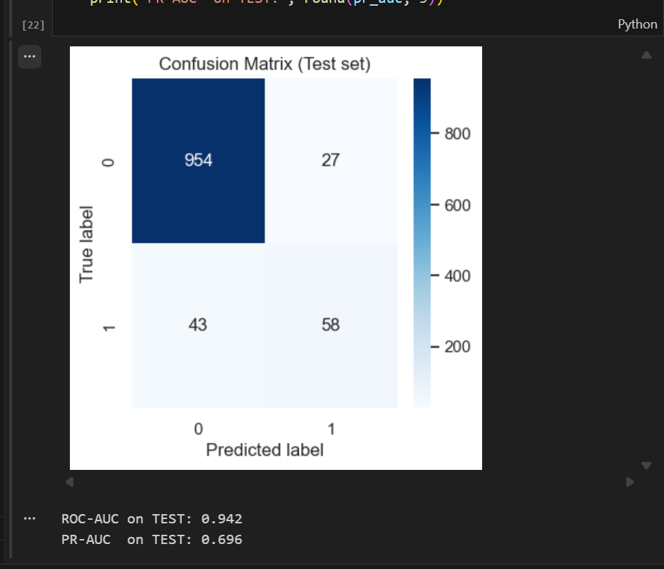
FINAL MODEL PREFORMANCE
Final model evaluated on unseen test data
Key metrics:
Precision
Recall
F1-Score
ROC-AUC
PR-AUC

Slide 11
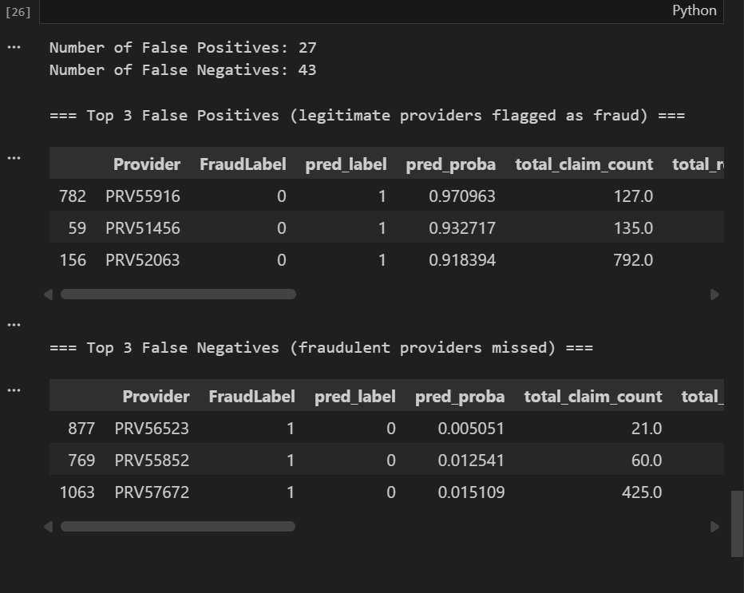
ROC
Shows trade-off between True Positive Rate and False Positive Rate
Higher AUC (> 0.85) indicates strong separation ability

Slide 12
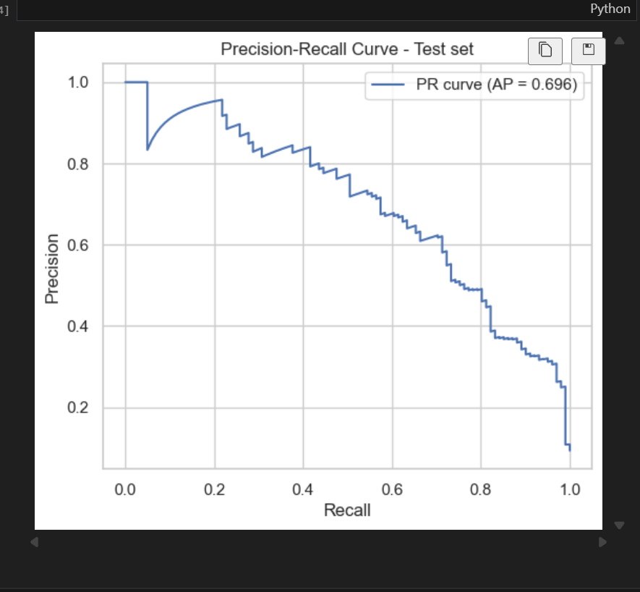
PRECISION RECALL
PR curve focuses on minority fraud class
High PR-AUC indicates reliable fraud detection

Slide 13
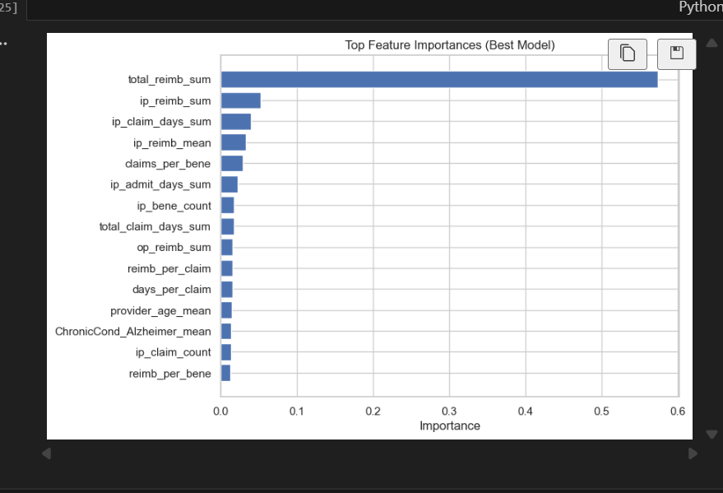
FEATURE IMPORTANCE
Top important features include:
Total reimbursed amount
Claims per beneficiary
IP/OP claim ratio
Average claim duration

Slide 14
ERROR ANALYSIS
False Positives:
Legitimate providers incorrectly flagged
Leads to wasted investigation resources
False Negatives:
Fraudulent providers missed
Most serious → undetected financial loss
Observed patterns:
Some false negatives had few claims
Some false positives had unusually long claim durations

Slide 15
BUSINESS IMPACT
Reduces audit workload by prioritizing risky providers
Helps prevent financial losses
Improves quality and integrity of Medicare operations
Enables continuous ML-based fraud monitoring

Slide 16
FUTURE WORK
Add temporal modeling (time-based fraud trends)
Experiment with XGBoost / LightGBM
Deploy model as an API for live scoring
More advanced feature engineering and deep learning approache

Slide 17
THANK YOU FOR YOUR ATTENTION
Any questions?

